Slide 1
Subject Name : SOFTWARE TESTING Presentation Title: METAMORPHIC TESTING
JEPPIAAR INSTITUTE OF TECHNOLOGY
“Self-Belief | Self Discipline | Self Respect”
Department of Computer Science and Engineering
Team Members:
Students Name
1. Abilash.V
2. Dinesh Kumar.P
3. HariPrasath.S
4. Madhan Kumar.S
5. Naveen . S
6.Senthzhalal

Slide 2
METAMORPHIC TESTING

Slide 3
METAMORPHIC TESTING
Properly based software testing
It can be eﬀective approach for addressing the test oracle problem
The test oracle problem is the diﬃculty of determining testcases

Slide 4
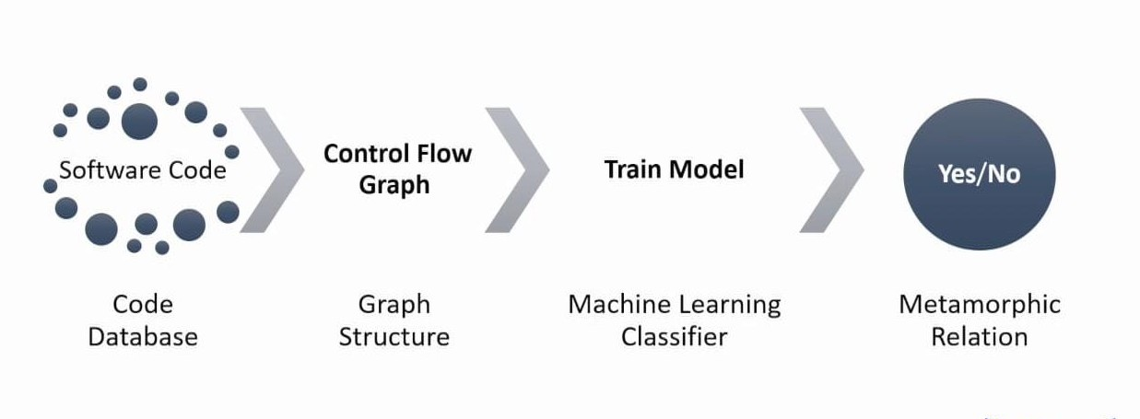
I M P L E M E N T A T I O N F L O W
●

Slide 5
USES
Metamorphic testing was invented by T.Y
More than 150 international researchers applied this technique to real-time applications
It is used in web services,computer graphics,embedded systems,machine learning, components,numericalanalysis and compliers.

Slide 6
FUNCTION
MT can be applied independently,and aslo combined with other static and dynamic software analysis techniques such as proving and debugging
MT is initially proposed as a software veriﬁcation technique then it was later developed into a paradigm
MT covers the veriﬁcation,validation,and other types of software quality assessment

Slide 7
MOTIVATION
The simplest way is with a manual oracle. Read out a sentence and conﬁrm it gives you that sentence.
But this isn’t nearly enough! The range of human speech is enormous. It’d be better if we could instead test 1,000 or 10,000 diﬀerent sound ﬁles.
Manually transcribing oracles is going to be way too expensive. This means we have to use property-based testing instead.

Slide 8
PROCESS
Double the volume, or
Raise the pitch, or
Increase the tempo, or
Add some background static, or
Add some traﬃc noises, or
Do any combination of the above.

Slide 9
CASE STUDIES
1. M E T T L E
METTLE: A Metamorphic Testing Approach To Validating Unsupervised Machine Learning Methods
Unsupervised machine learning is the training of an artiﬁcial intelligence system using information that is neither classiﬁed nor labeled, with a view to modeling the underlying structure or distribution in a dataset.

Slide 10
2 . D E E P T E S T
DeepTest: Automated Testing of
Deep-Neural-Network-driven Autonomous Cars
Recent advances in Deep Neural Networks (DNNs) have led to the development of DNN-driven autonomous cars that, using sensors like camera, LiDAR, etc., can drive without any human intervention.

Slide 11
FUTURE SCOPE
Abstract—Web Application Programming Interfaces (APIs)
allow systems to interact with each other over the network.
. Modern Web APIs often adhere to the REST architectural style, being referred to as RESTful Web APIs. RESTful Web APIs are decomposed into multiple resources (e.g., a video in the YouTube API) that clients can manipulate through HTTP interactions
a. key challenge in compiler testing is the lack of an oracle that classiﬁes an output as correct or incorrect; this is particularly pertinent in gra●phics shader compilers where the output is rendered image that is typically underspeciﬁed

Slide 12
REFERENCE
https://www.hillelwayne.com/----- Hillel Wayne
https://www.researchgate.net/----D.H.Huang

